Slide 1
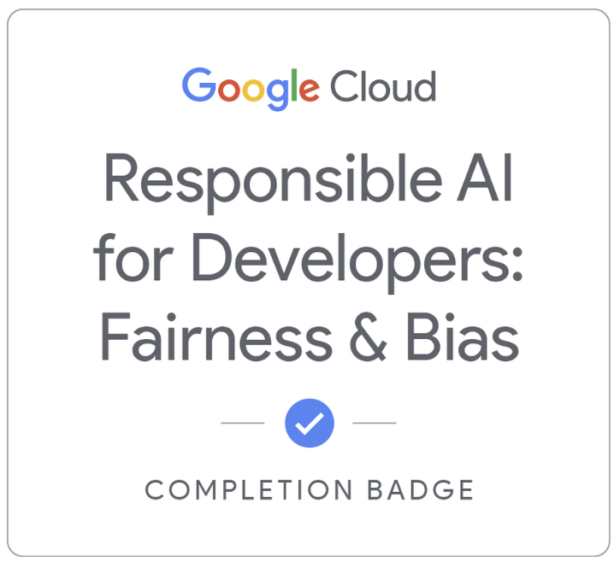

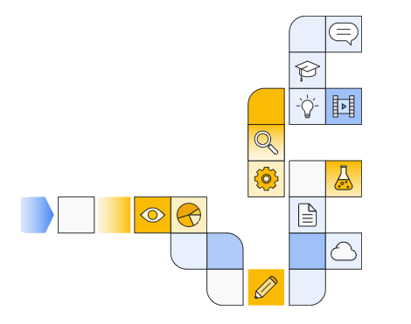

Notes:
https://www.cloudskillsboost.google/paths/183/course_templates/542/

Slide 2
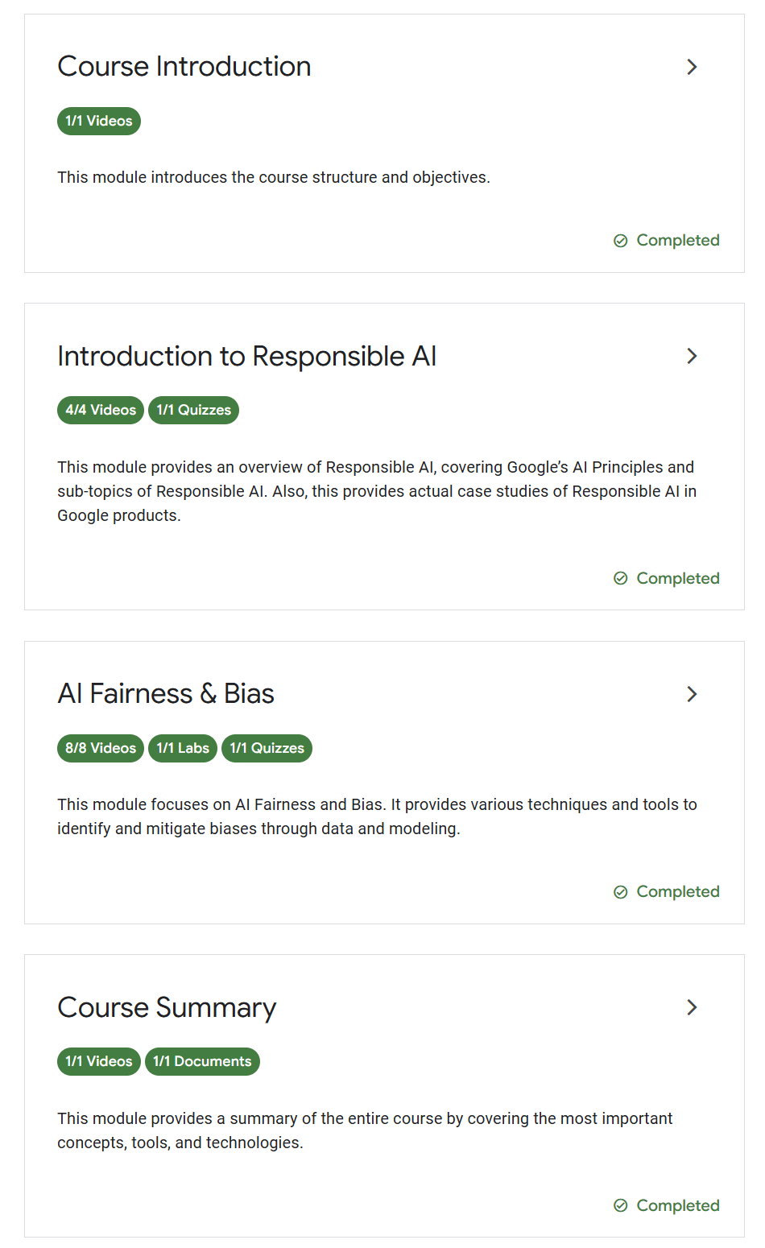

Slide 3
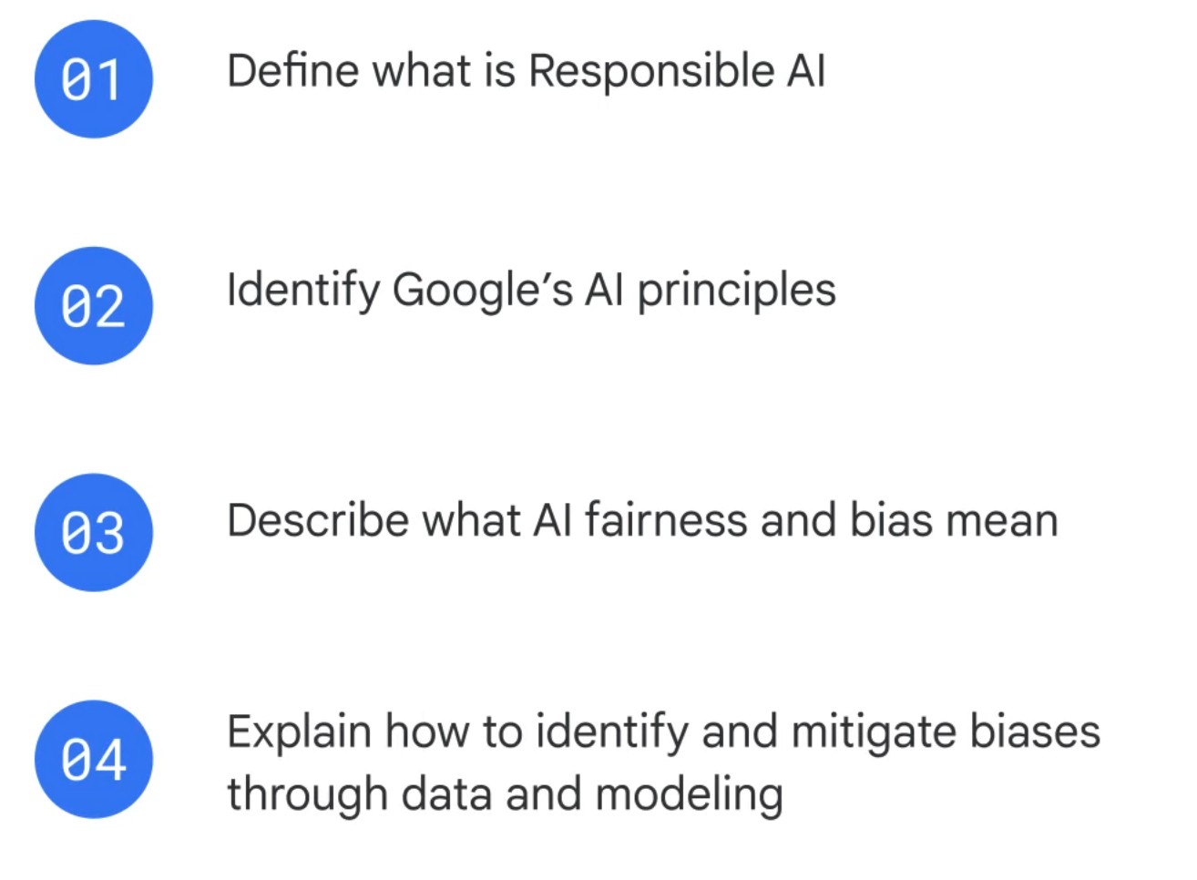

Slide 4


Slide 5
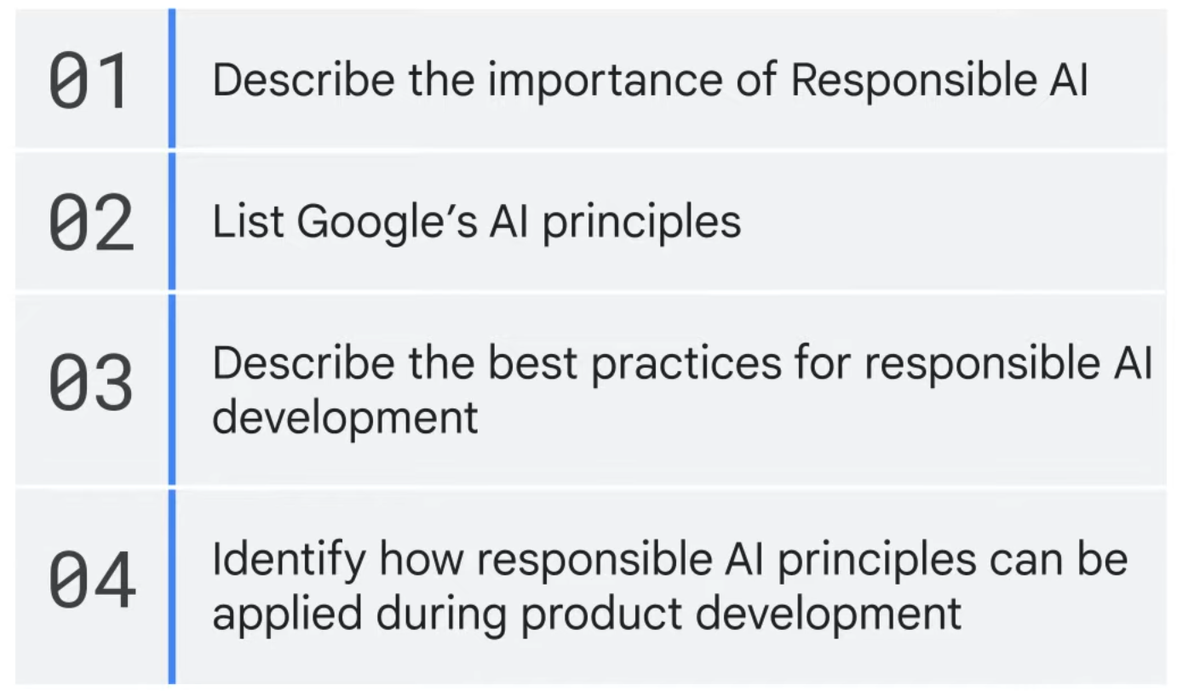
Notes:
https://www.cloudskillsboost.google/course_templates/981/labs/514648

Slide 6
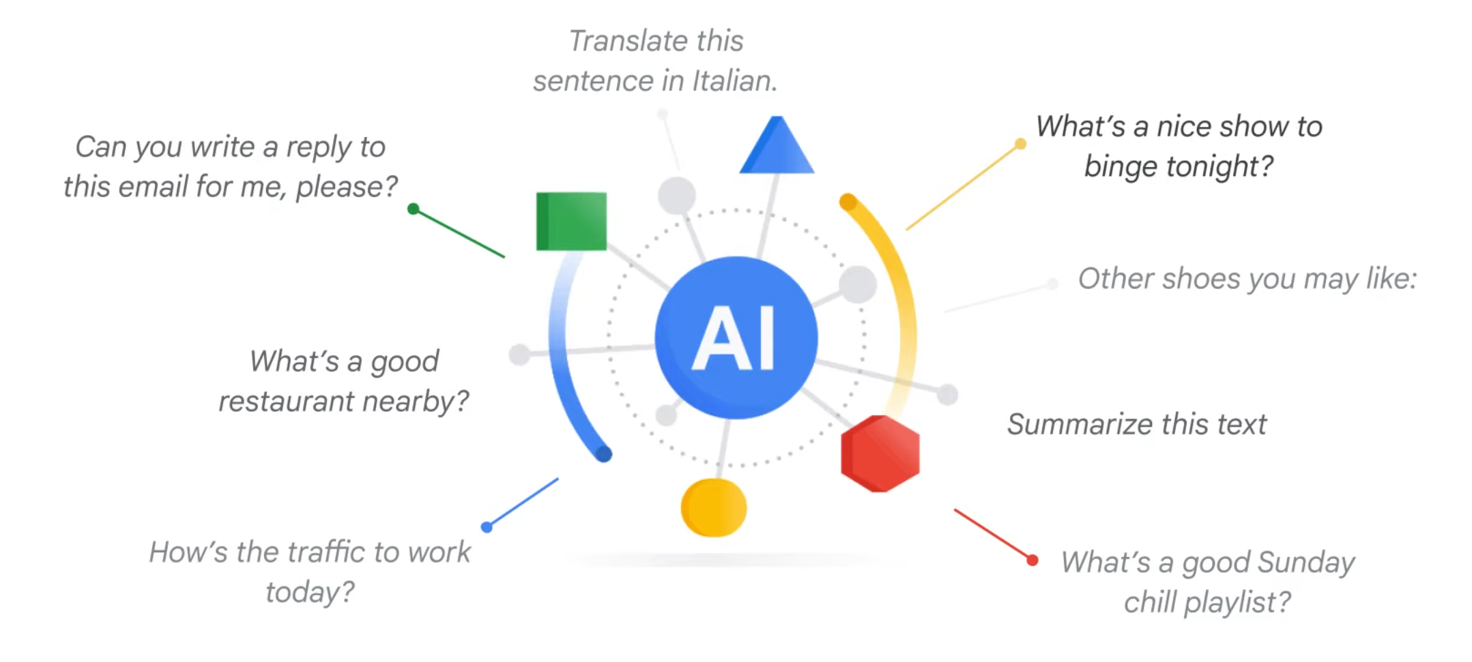

Slide 7
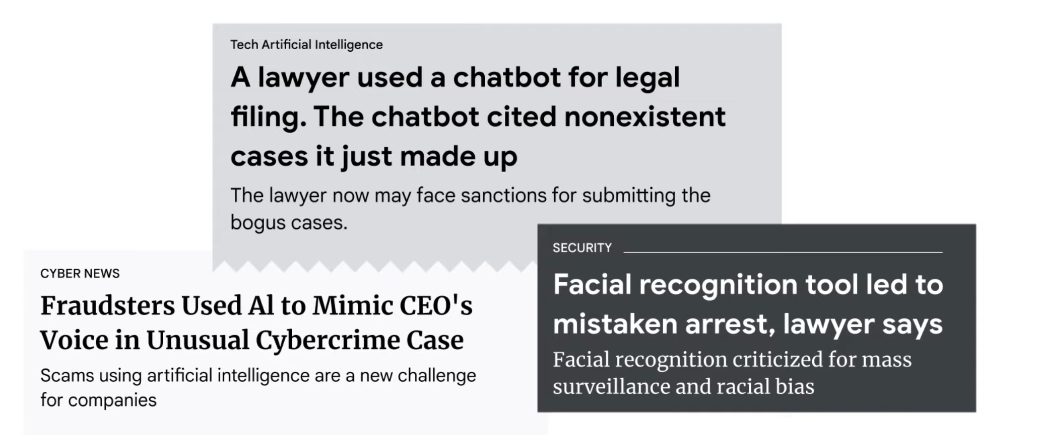

Slide 8
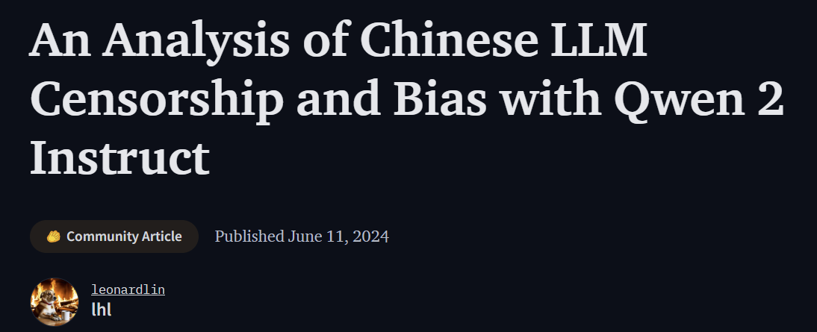
Notes:
https://huggingface.co/blog/leonardlin/chinese-llm-censorship-analysis

Slide 9

Notes:
https://www.yahoo.com/tech/google-pauses-absurdly-woke-gemini-153833934.html

Slide 10
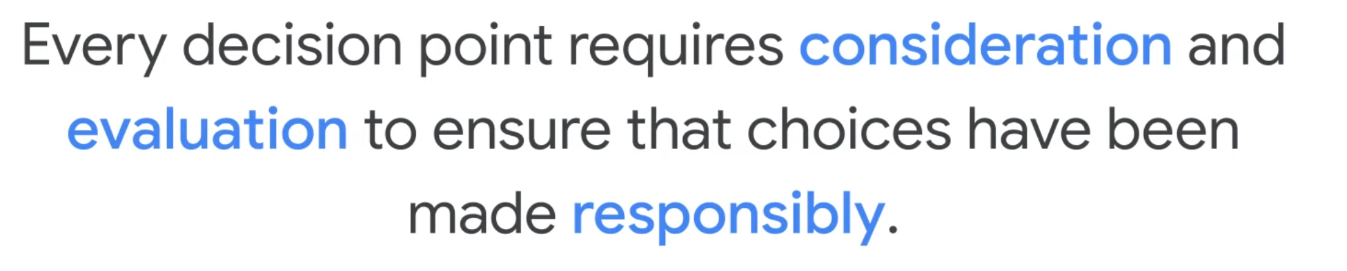

Slide 11
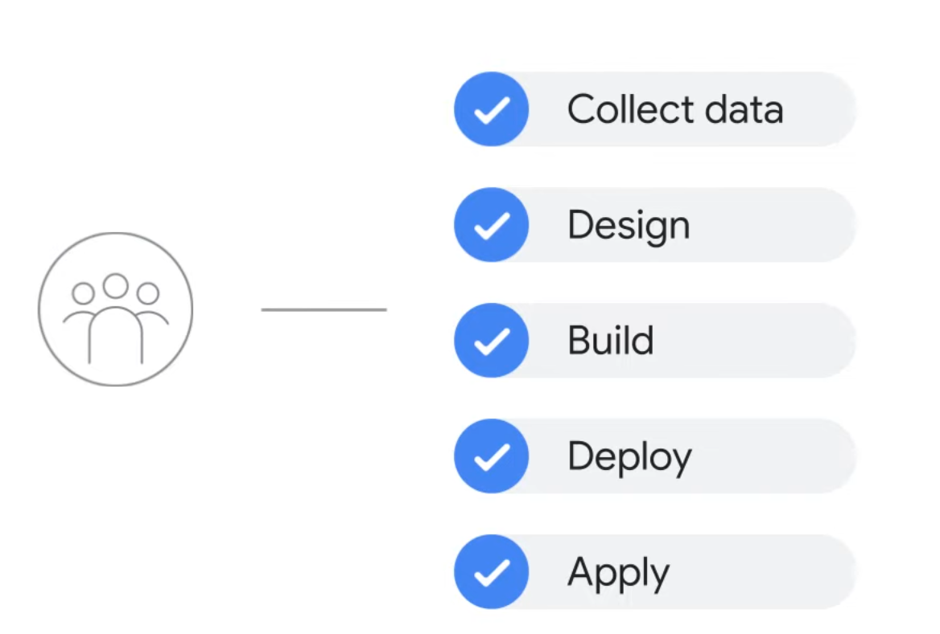

Slide 12


Slide 13
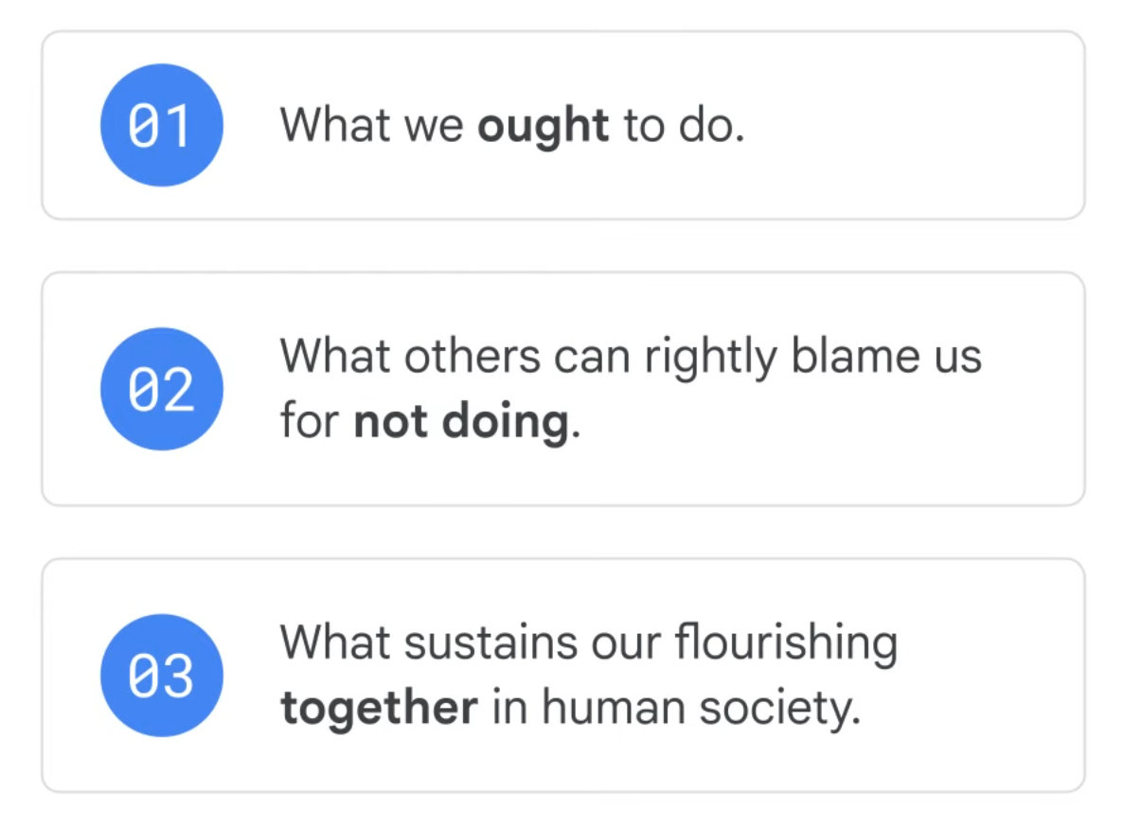

Slide 14
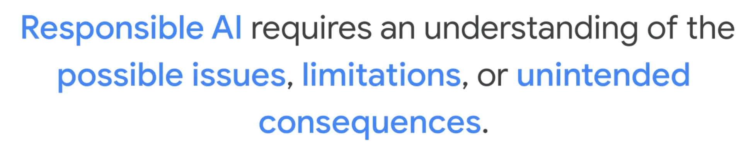

Slide 15
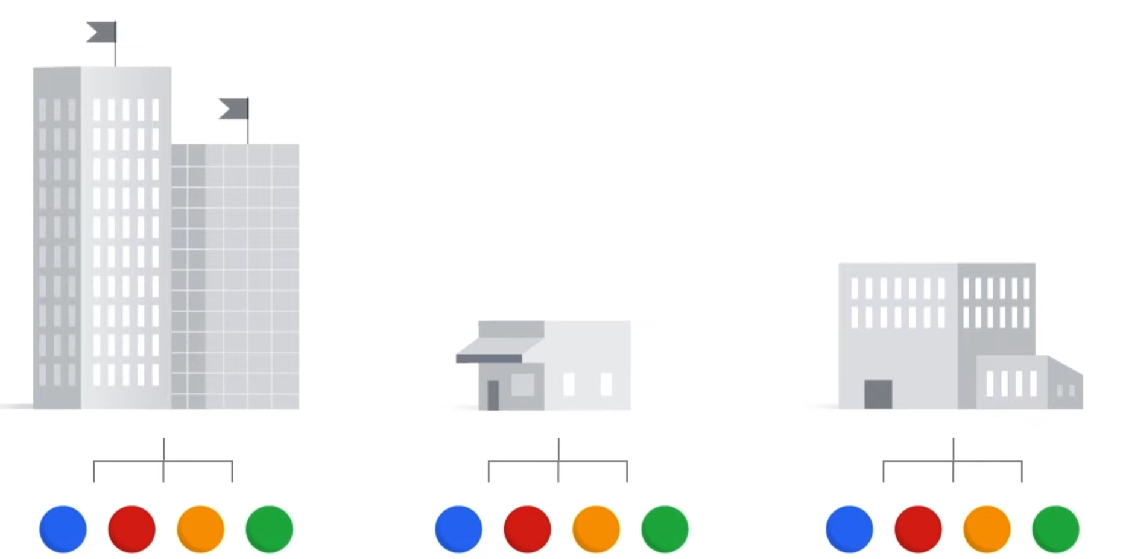

Slide 16
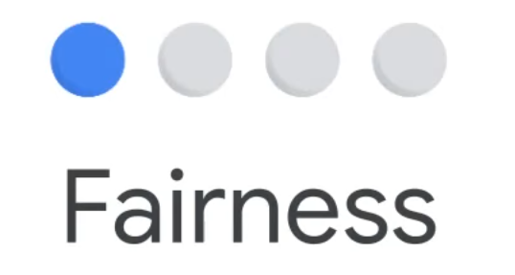




Slide 17
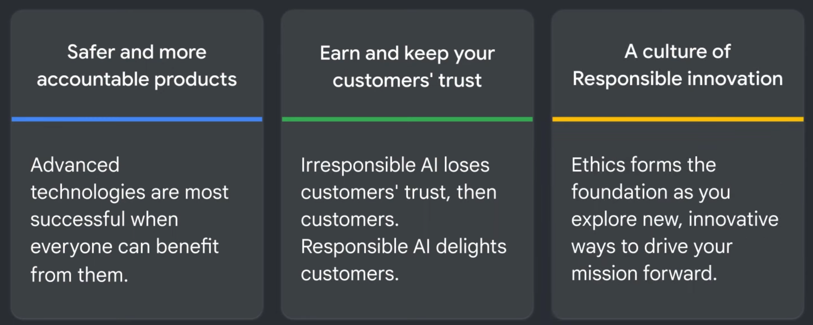

Slide 18
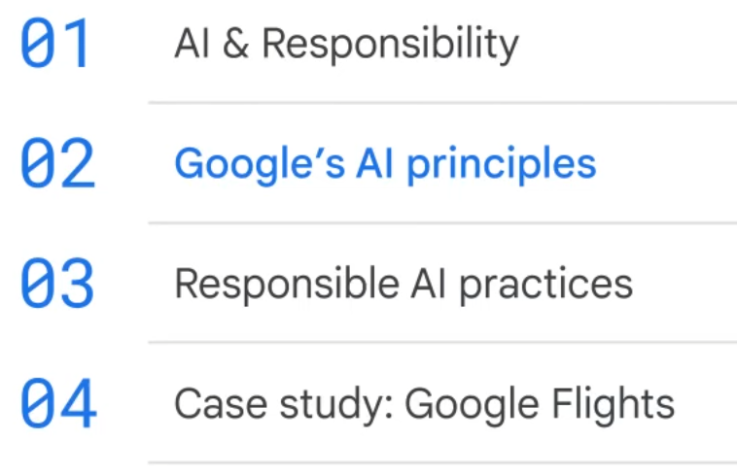

Slide 19
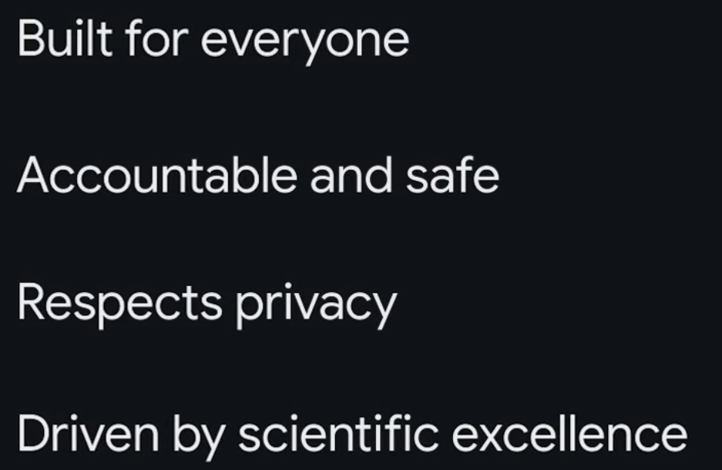

Slide 20
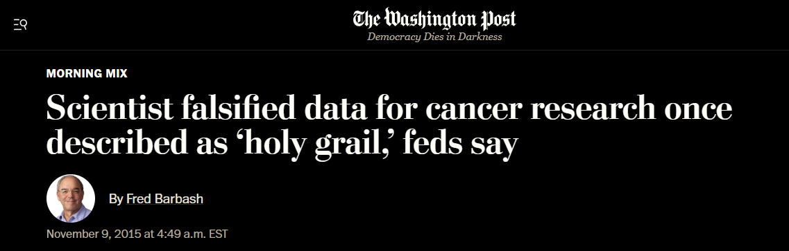
Notes:
https://archive.is/vOTJC

Slide 21
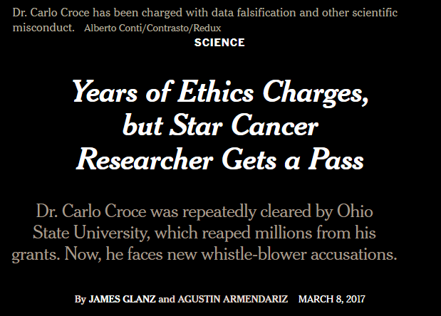
Notes:
https://archive.is/dwbY0

Slide 22
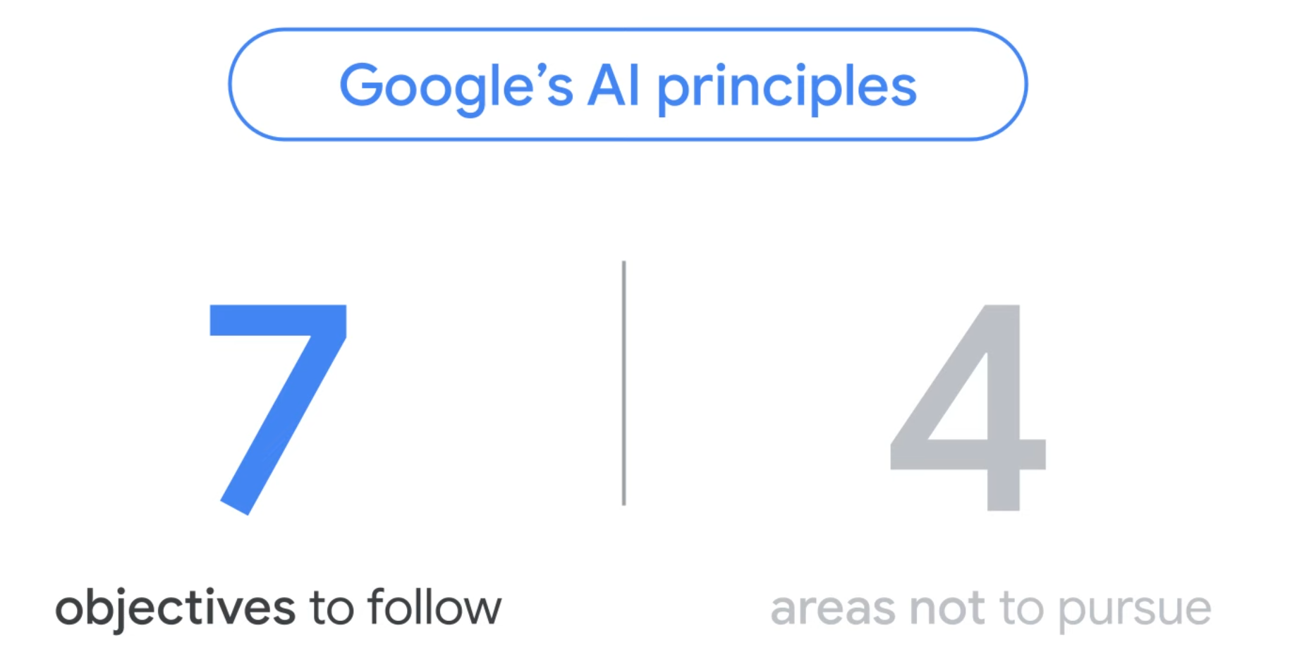
Notes:
https://ai.google/static/documents/EN-AI-Principles.pdf

Slide 23
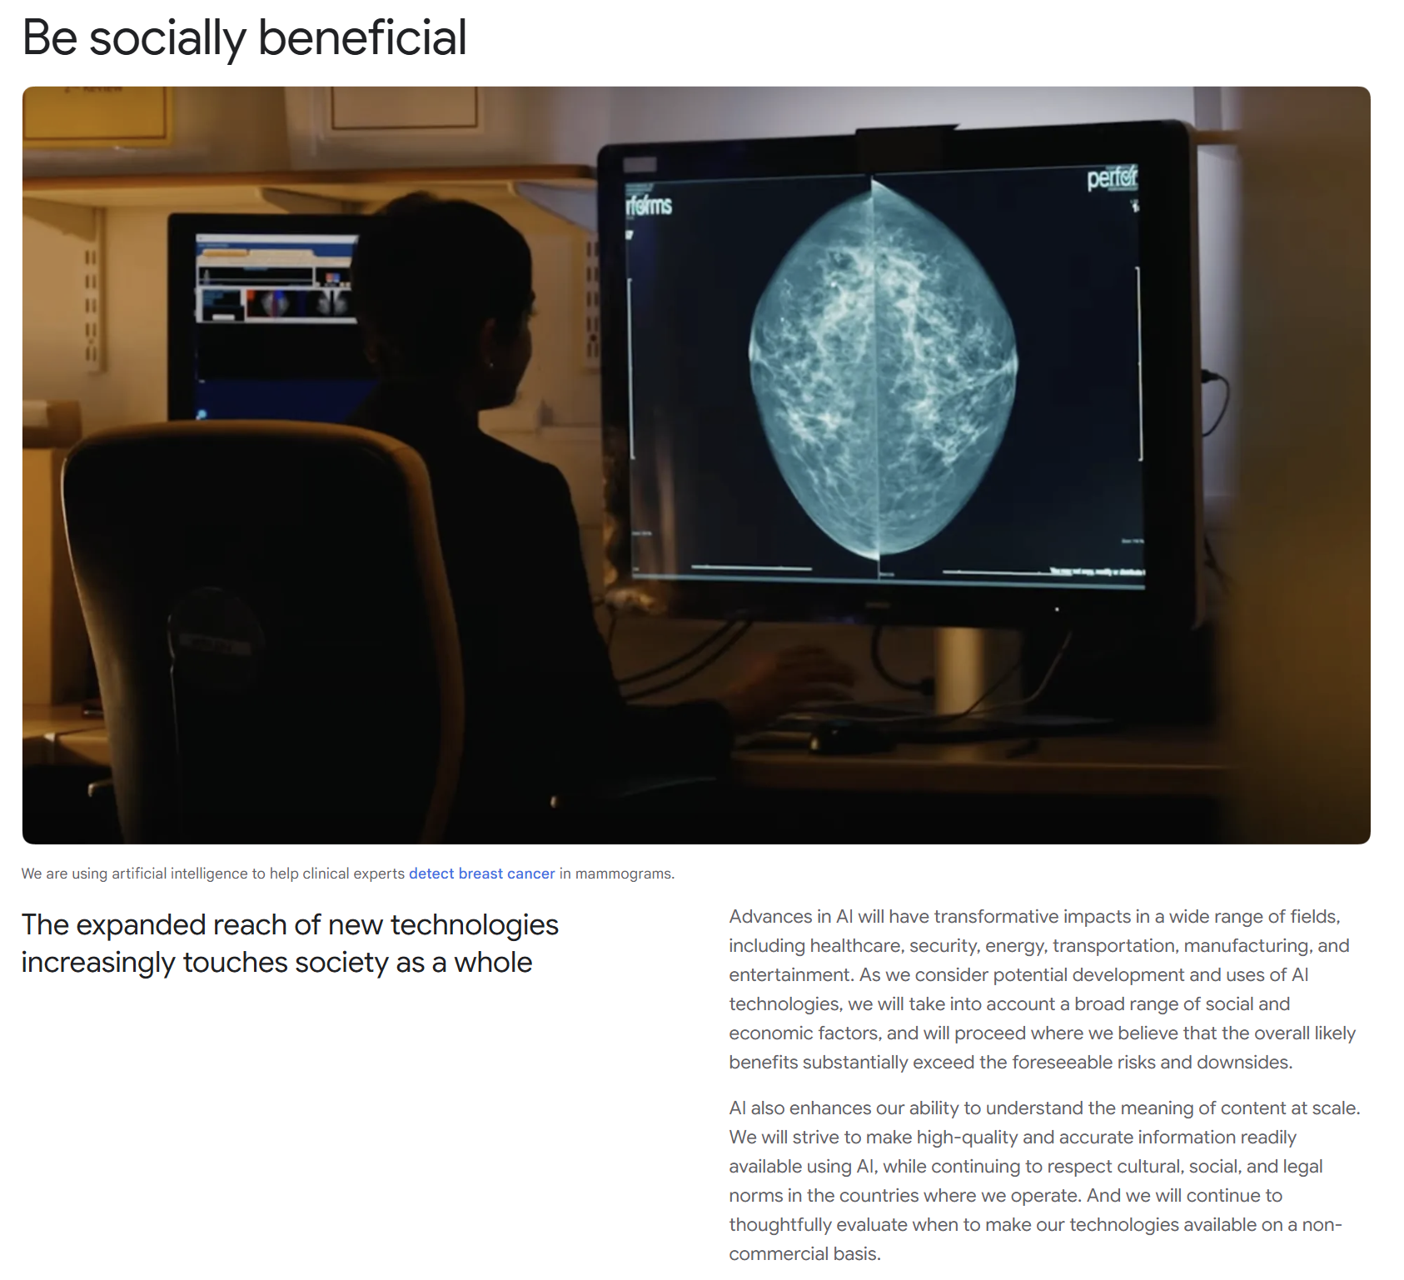
Notes:
https://ai.google/responsibility/principles/

Slide 24
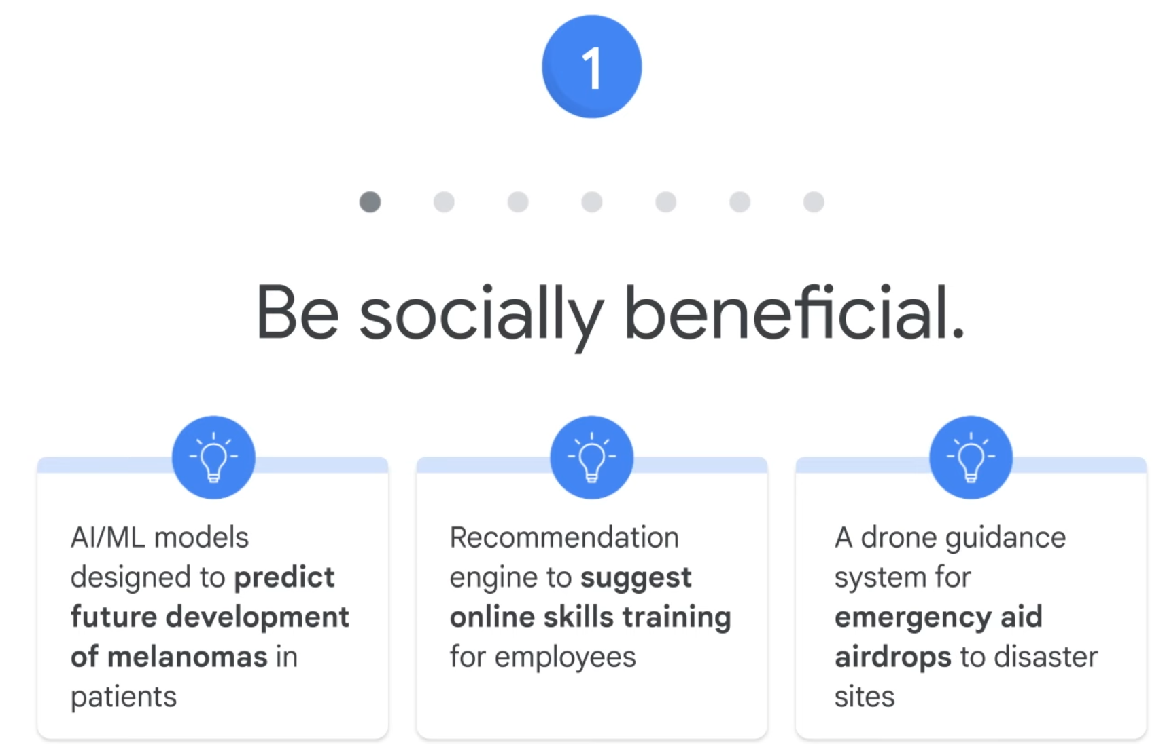

Slide 25
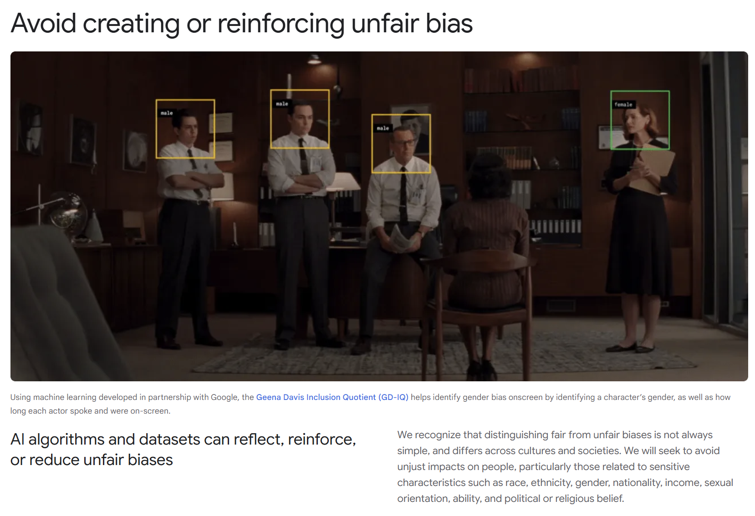
Notes:
https://ai.google/responsibility/principles/

Slide 26
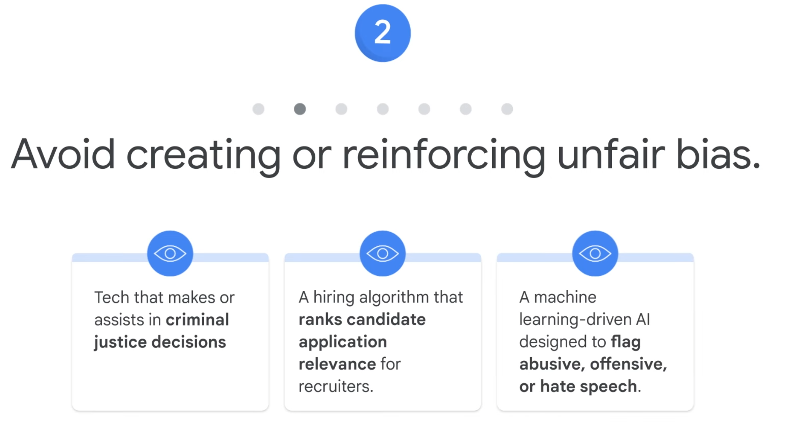

Slide 27
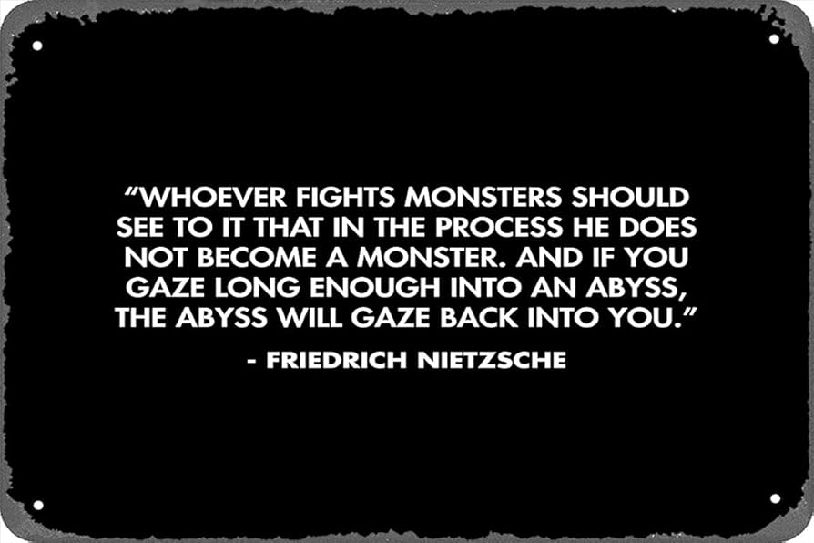

Slide 28

Notes:
https://www.bloomberg.com/graphics/2023-black-lives-matter-equal-opportunity-corporate-diversity/

Slide 29
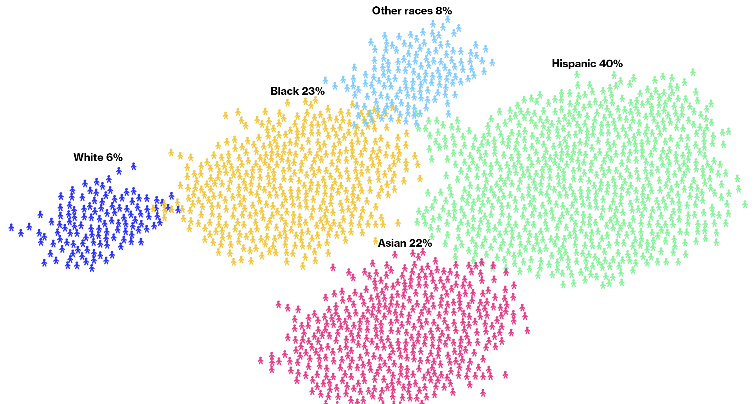
Actual 5.4%
Actual 12.1%
Actual 18.7%
Actual 57.8%
Actual 6.0%
Notes:
https://www.bloomberg.com/graphics/2023-black-lives-matter-equal-opportunity-corporate-diversity/
https://www.census.gov/2020results

Slide 30

Notes:
https://ai.google/responsibility/principles/

Slide 31
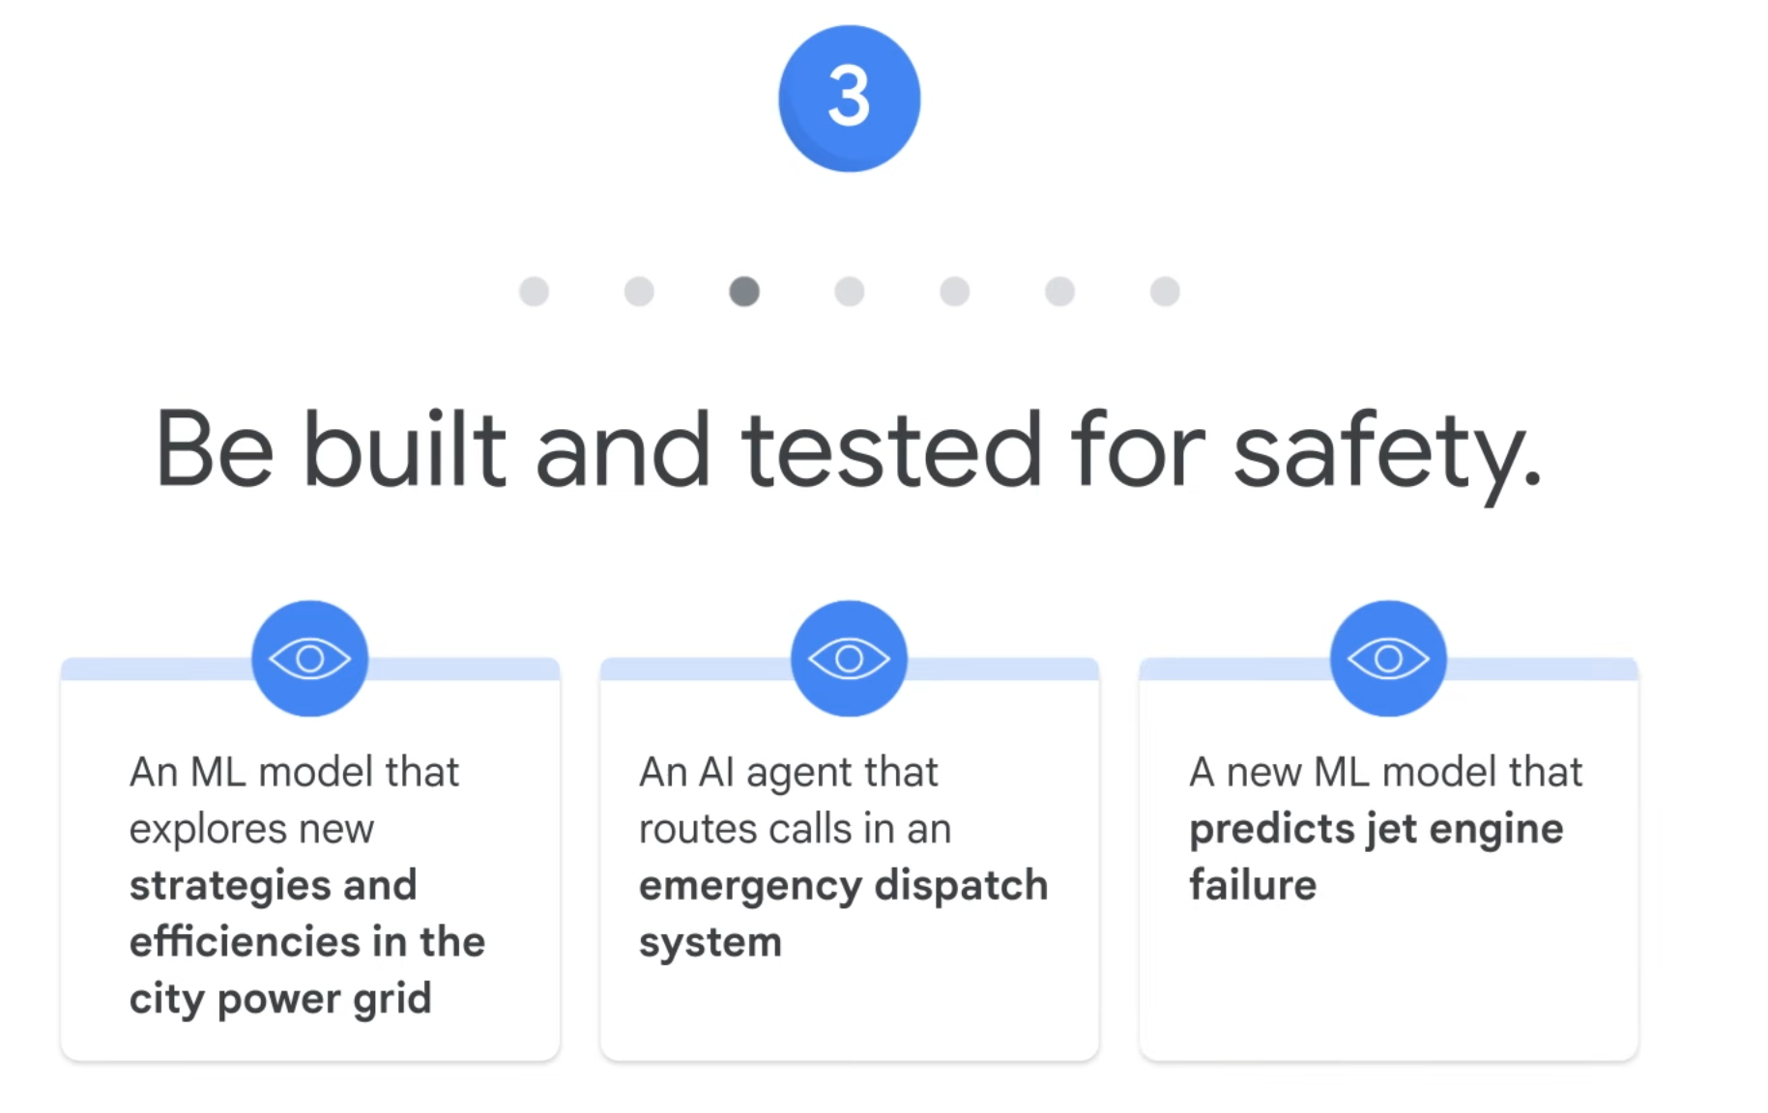

Slide 32
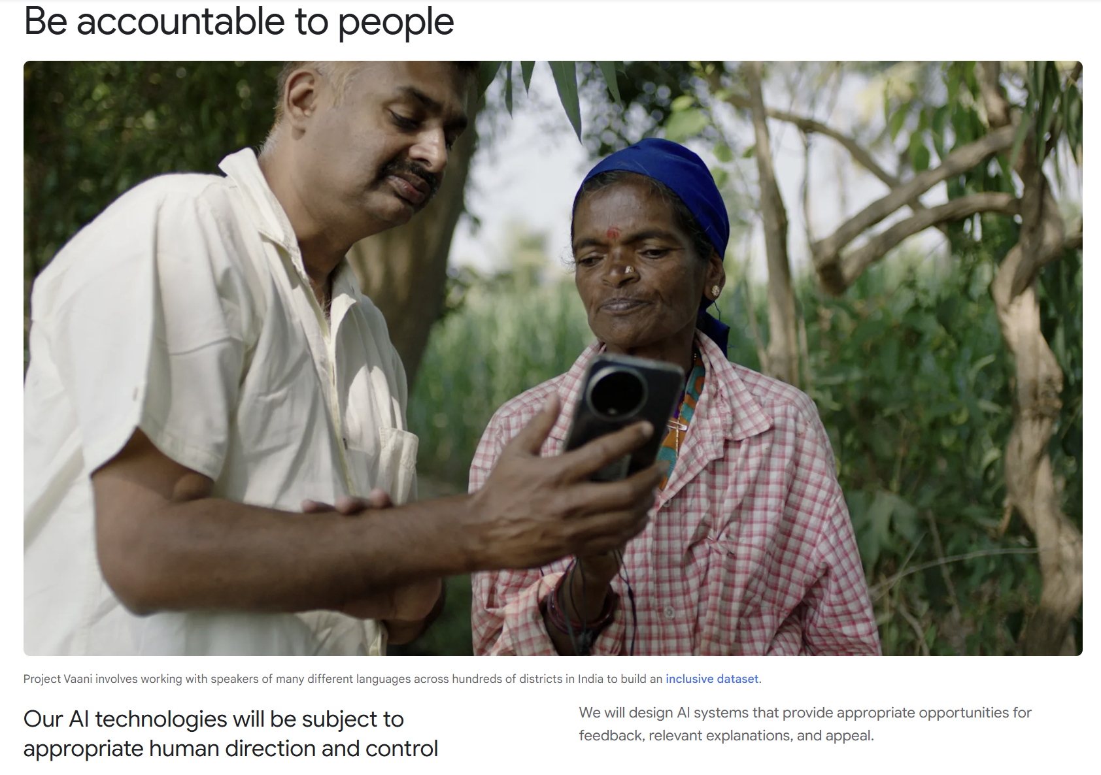
Notes:
https://ai.google/responsibility/principles/

Slide 33
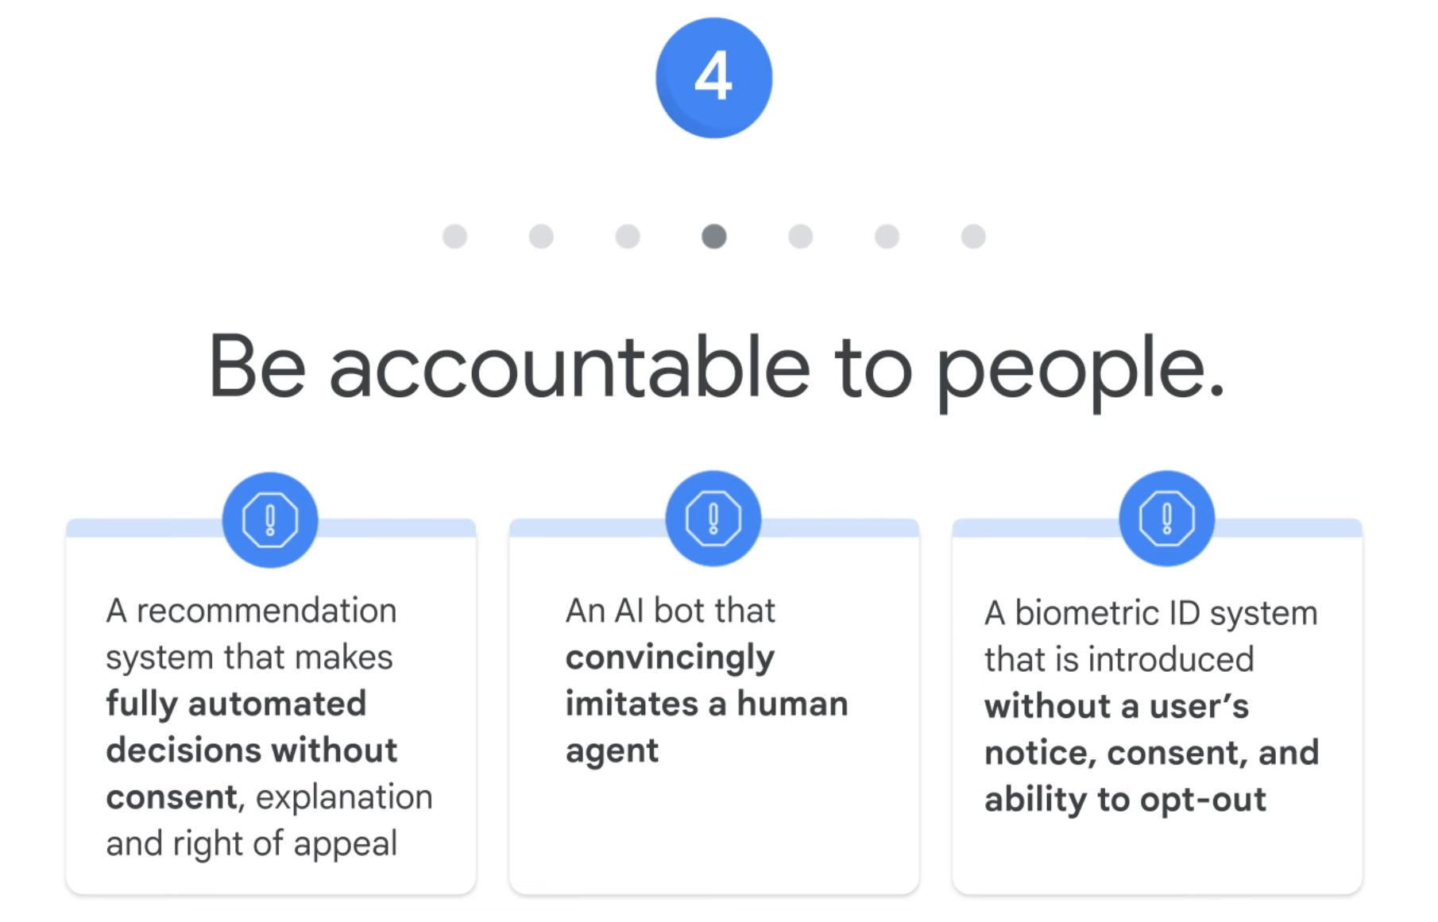

Slide 34
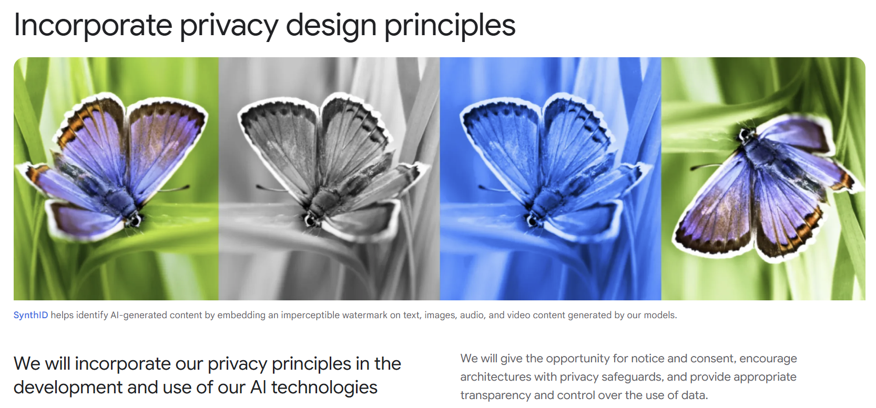
Notes:
https://ai.google/responsibility/principles/

Slide 35
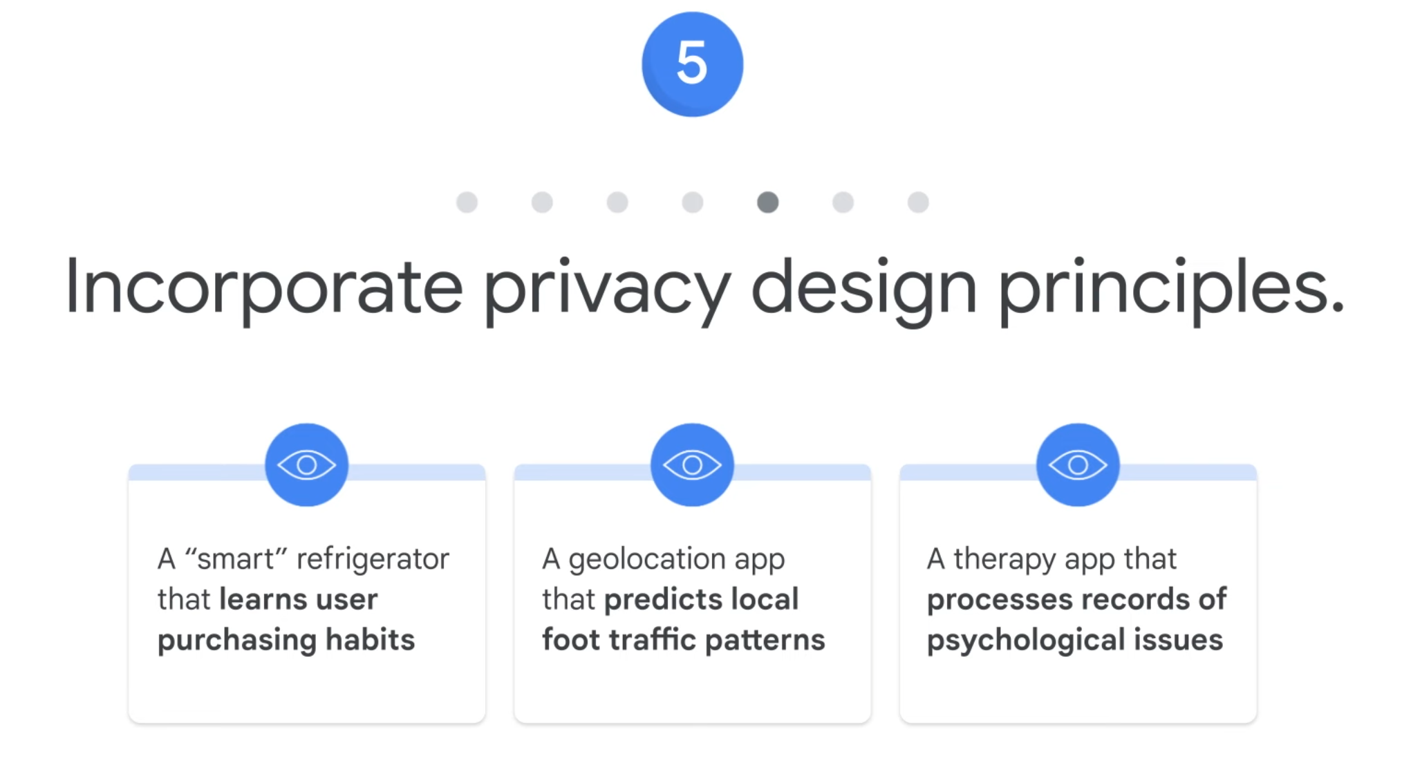

Slide 36
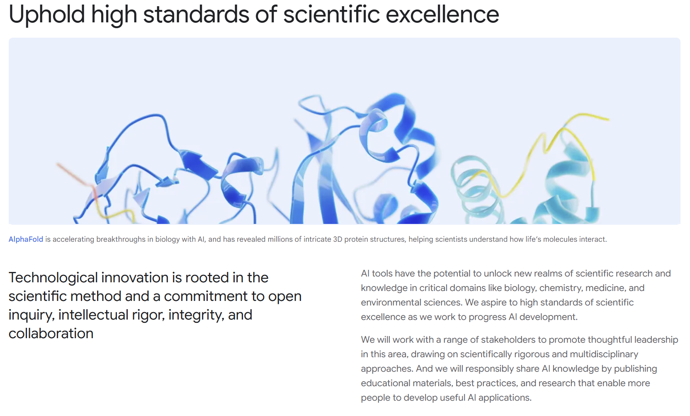
Notes:
https://ai.google/responsibility/principles/

Slide 37
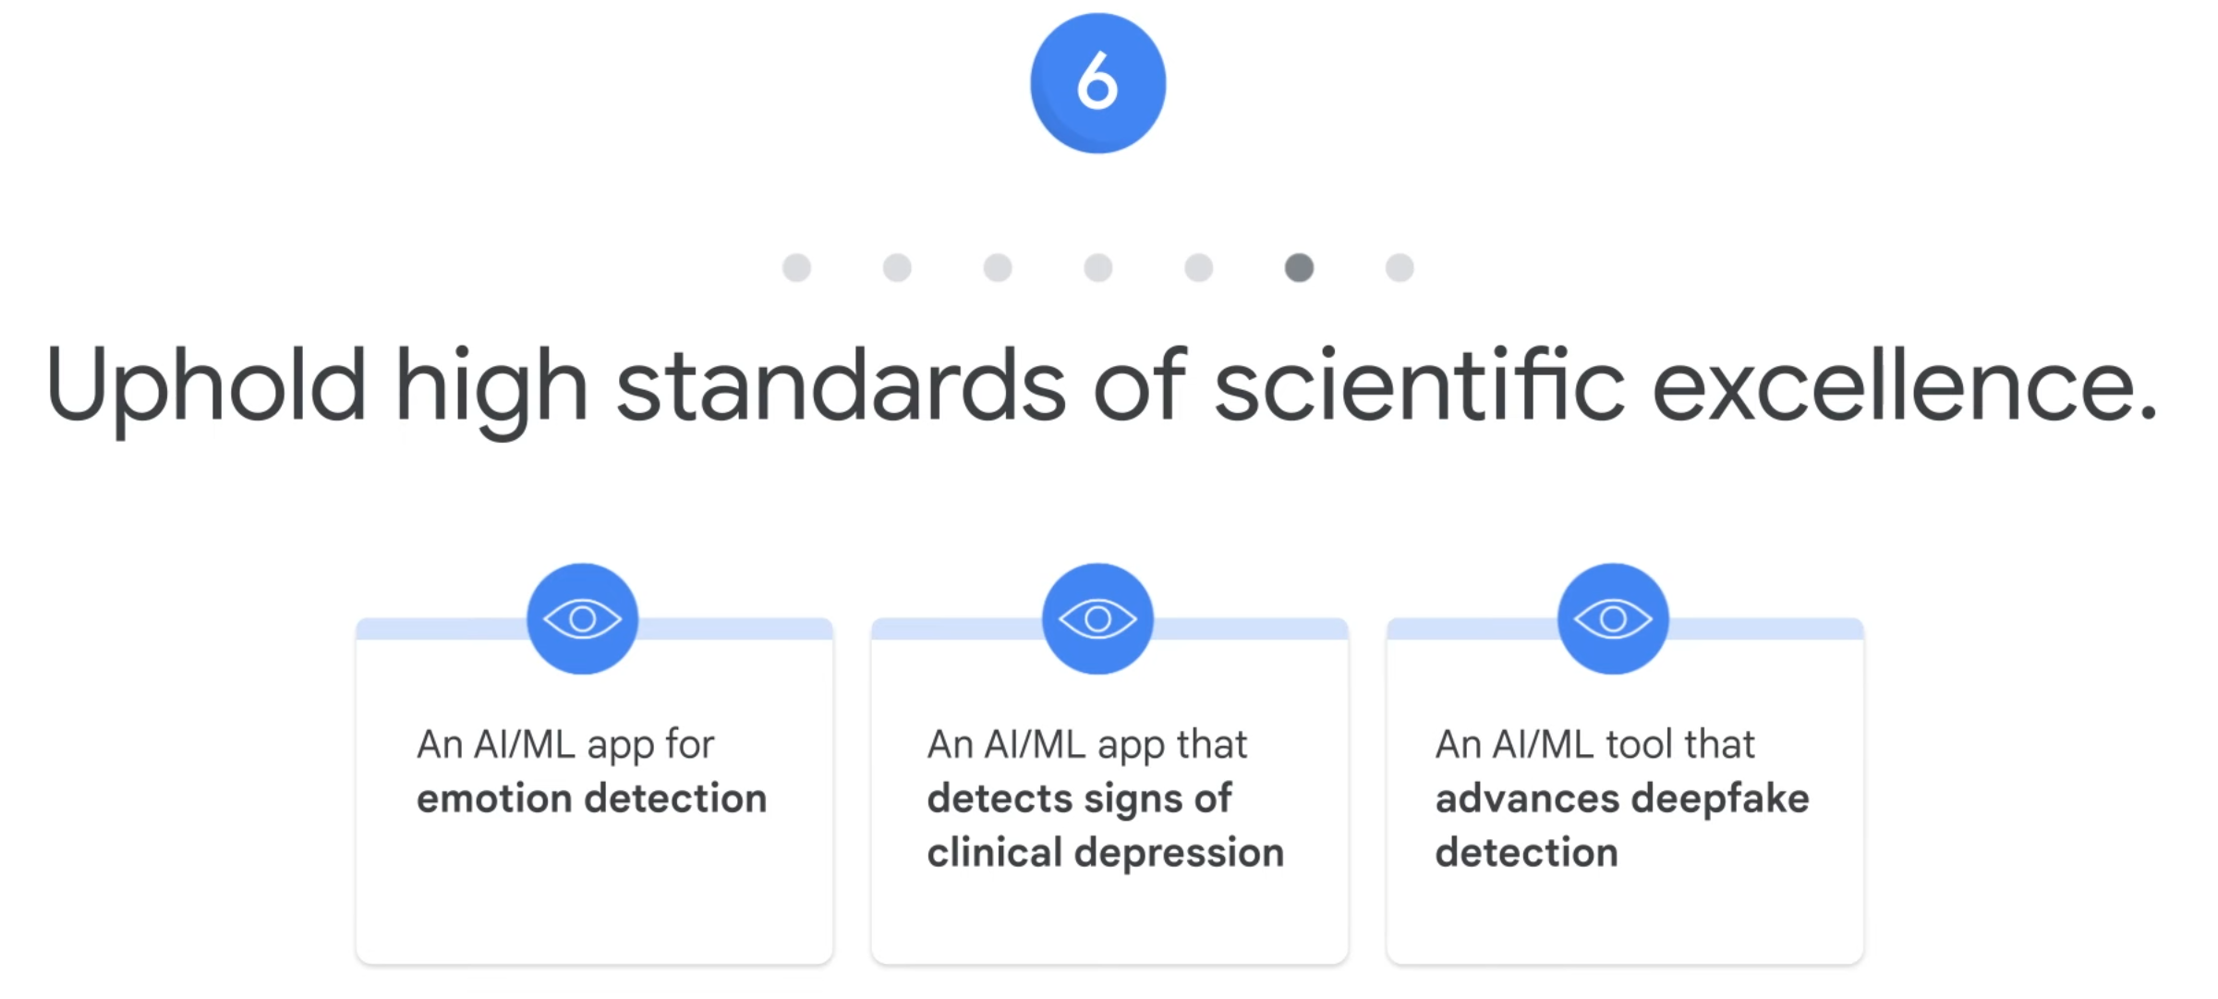

Slide 38
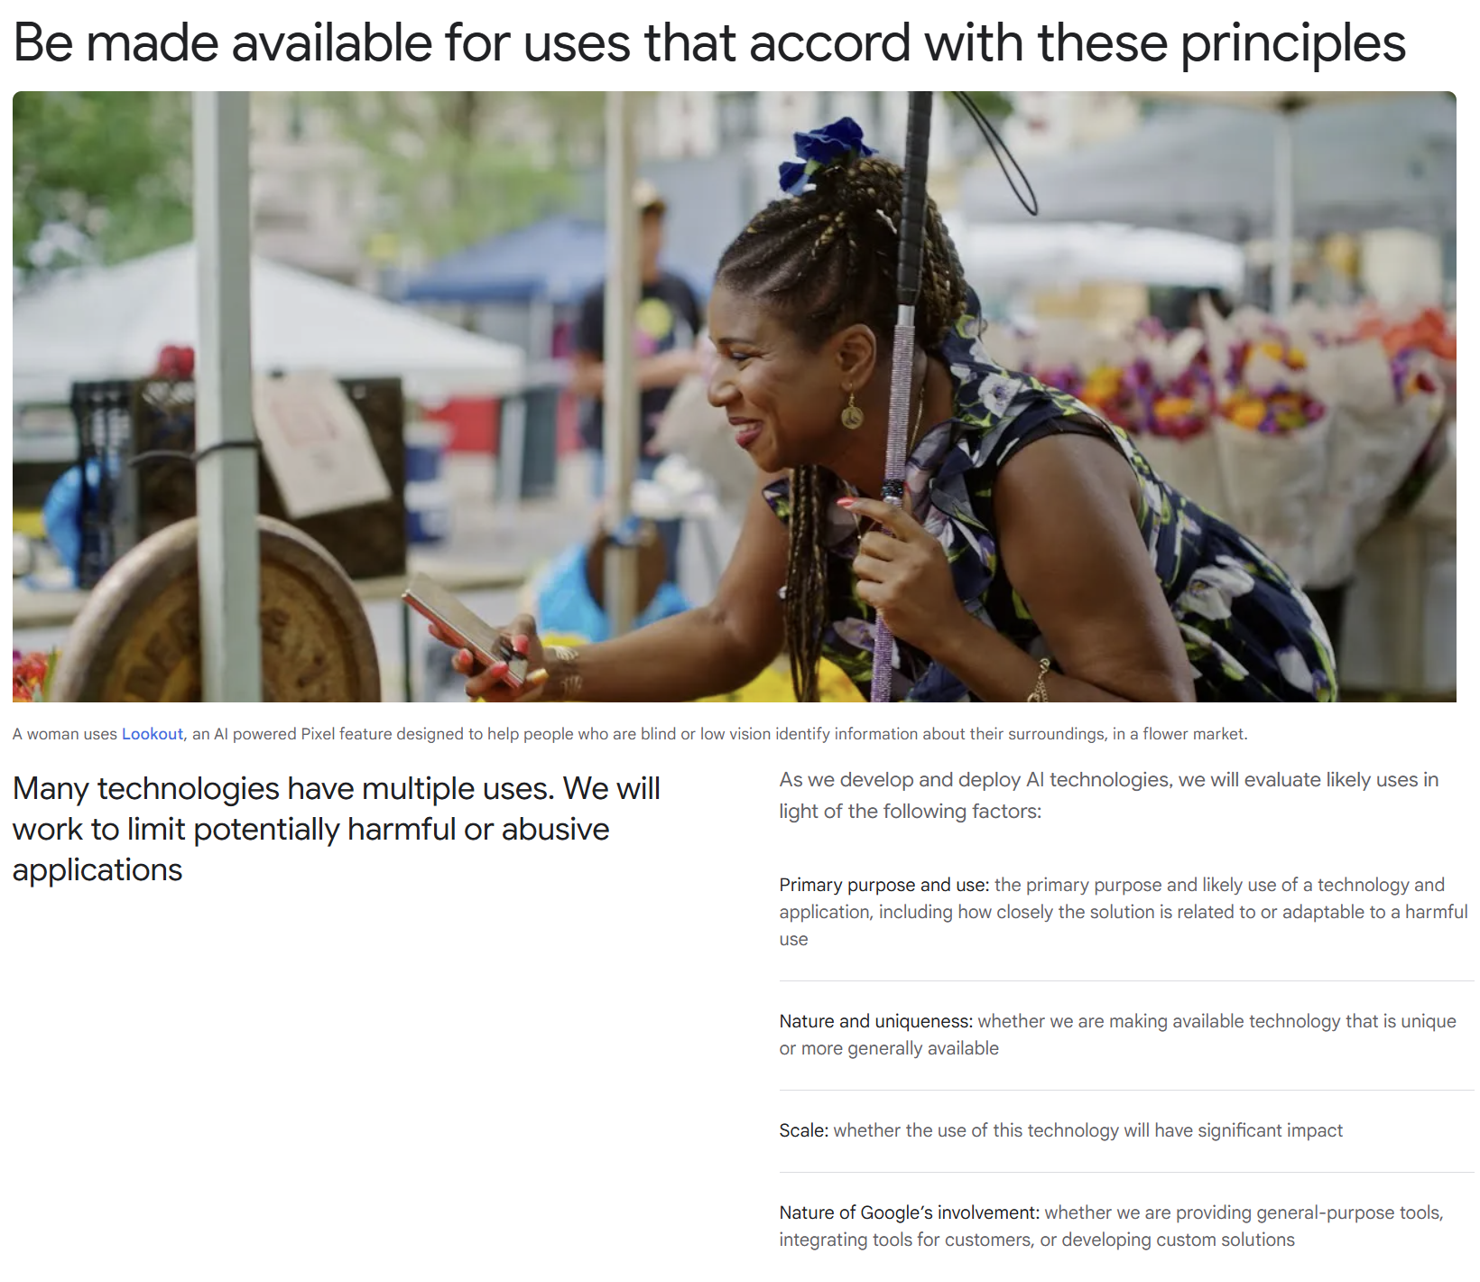
Notes:
https://ai.google/responsibility/principles/

Slide 39
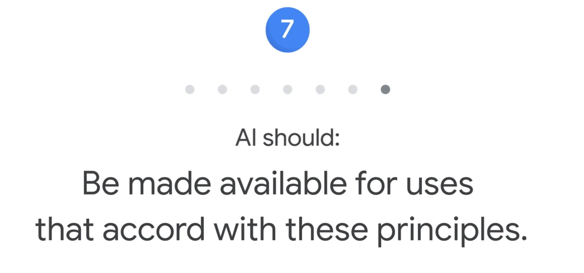

Slide 40
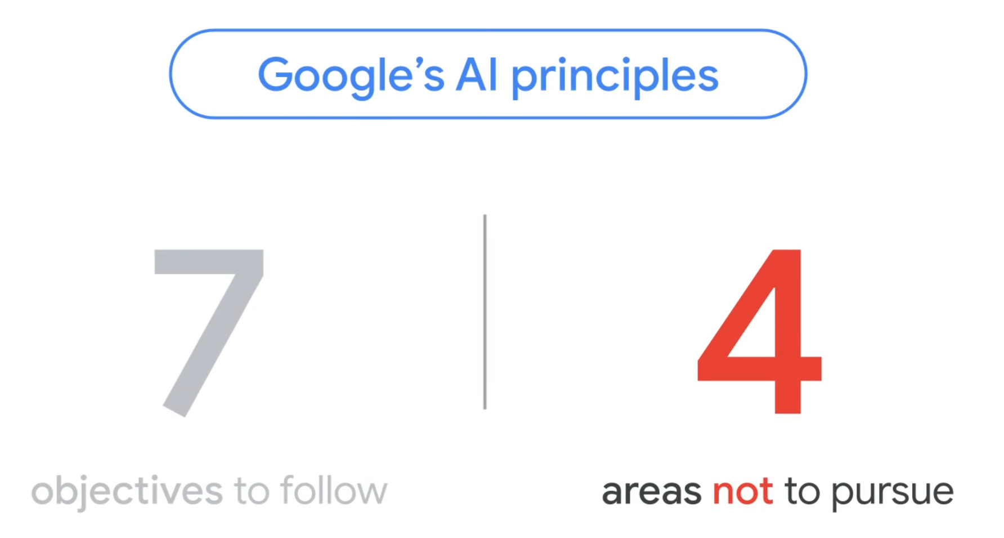

Slide 41
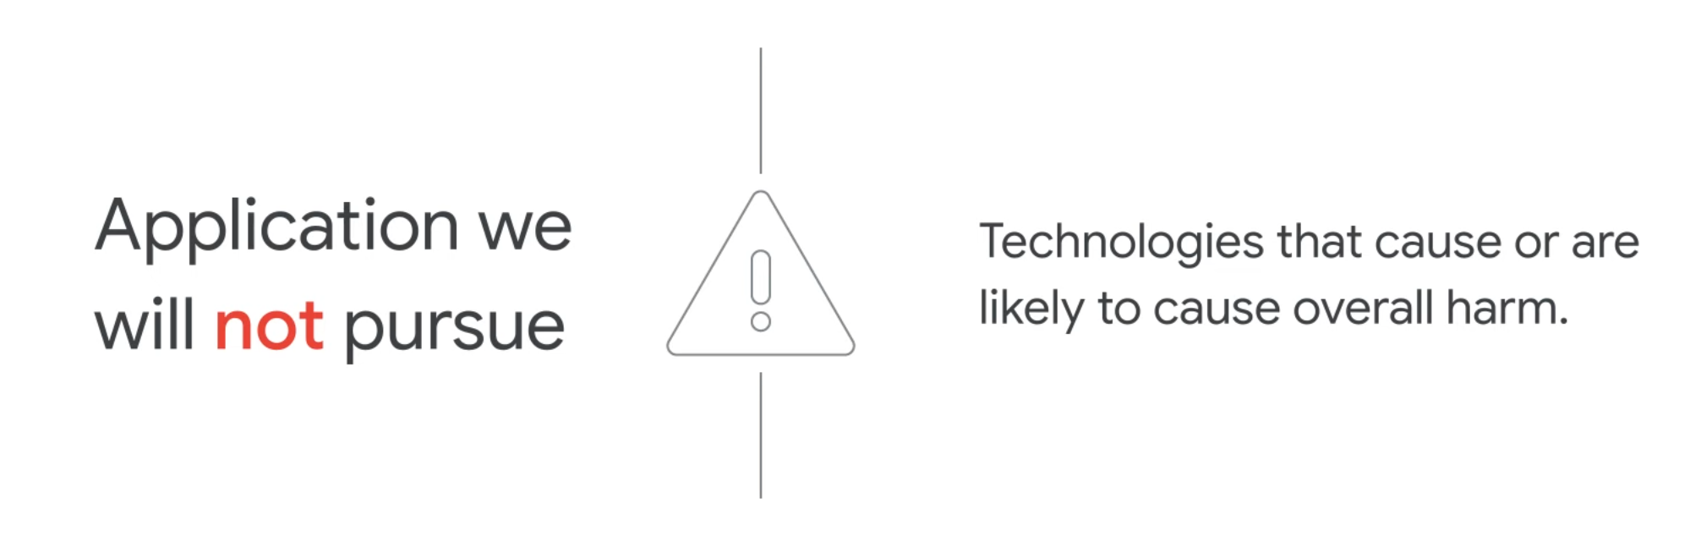
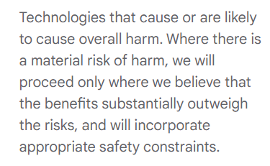

Slide 42
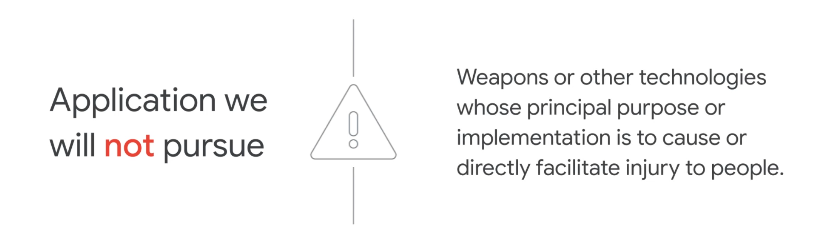

Slide 43
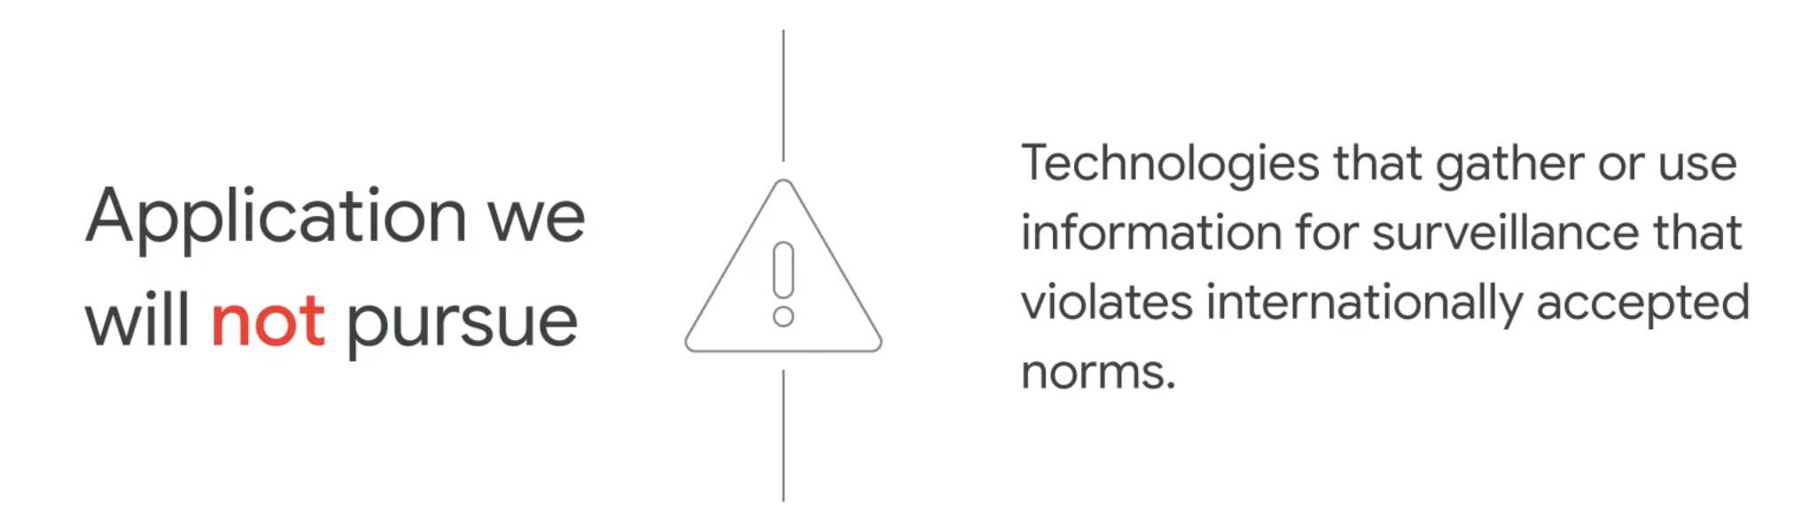

Slide 44
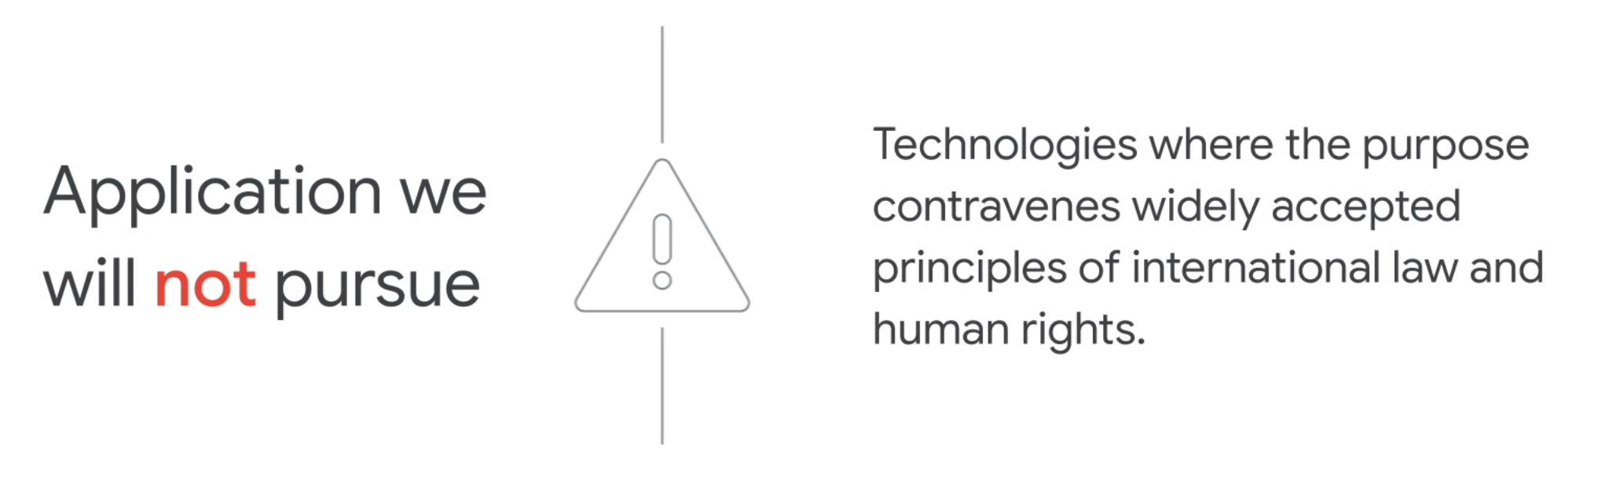

Slide 45


